Slide 1
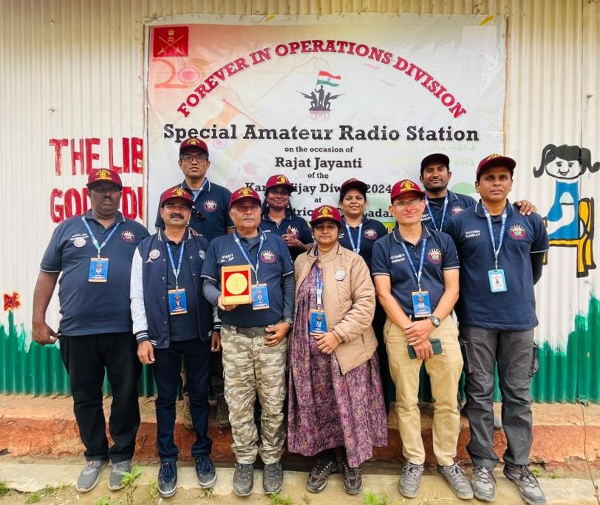
INDIAN INSTITUTE OF HAMS (VU2IIH)
BENGALURU
Operated from 10/06/2024 - 14/06/2024
Team: Front row (left to right):
VU3CJM (Manju), VU3IGP (Hiremath), VU2FI (Dr. Sathyapal), VU3LXI (Lakshmi), VU3MBV (Mahesh), VU3OIM (Venkat)
Back row (left to right):
VU3UBN (Nandu), VU3DUG (Suganya), VU3FCE (Shilpa), VU3NVY (Monish)
INDIAN INSTITUTE OF HAMS (IIH) was established as a registered trust in 1993 for promoting Amateur (HAM) Radio in India, has reached yet another milestone of completing 31 years of continuous service. IIH is founded by Dr. Sathyapal, VU2FI and Sri. R.J.Marcus, VU2VTM. IIH is actively associated with Department of Youth Empowerment and Sports, Government of Karnataka having established Ham Radio Station and training centre at Kanteerava Outdoor Stadium, Kasturba Road, Bengaluru, 560 001, India. Indian Institute of Hams is affiliated to National Institute of Amateur Radio (NIAR), Hyderabad and Institutional Member, Amateur Radio Society of India (ARSI).
IIH has made tremendous strides in awareness on amateur radio and increasing population of Hams by approximately 10000 hams in INDIA, with its members spread all over the world. From its early days, IIH was well recognized for its activities and received "RAJIV GANDHI AWARD" for two consecutive years in 1995 and 1996 for best promotion of Ham Radio activities in India, award was presented by Smt. Sonia Gandhi who is also a Ham with a call sign VU2SON. Since 1993, IIH is continuously conducting Ham Radio Training programs and make them appear for Ham Radio Examination conducted by Ministry of Communication, Government of India. At least 5 batches are conducted every year. Institute has created Ham awareness to thousands of people specially students and also in social organizations like Rotary and Lions Club.
IIH is the only Ham institution maintaining 3 repeaters (VHF Analog, VHF Digital – DMR, UHF) for Hams.
Nets: Kho-Khro-Kho net, Good morning net, Evening net on VHF and UHF, Silicon City net on HF and VHF, DMR net.
OUR AIM : "EVERY EDUCATIONAL INSTITUTION SHOULD HAVE A HAM RADIO CLUB"

Slide 2
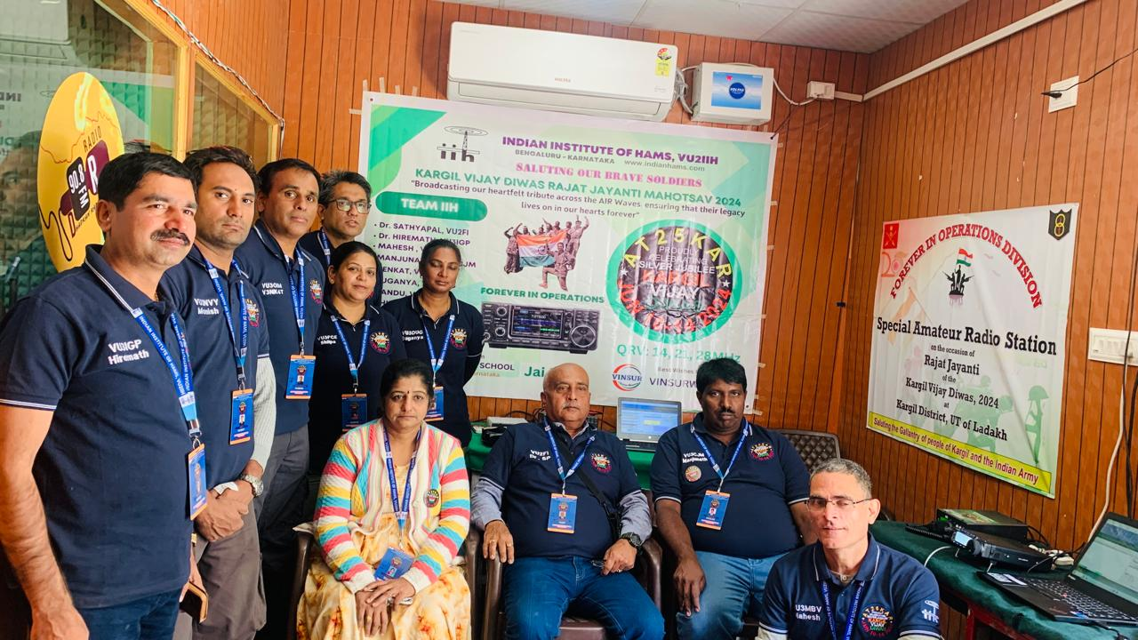
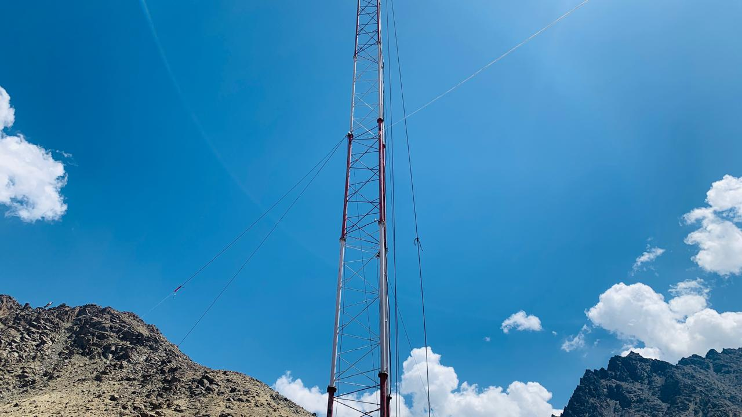
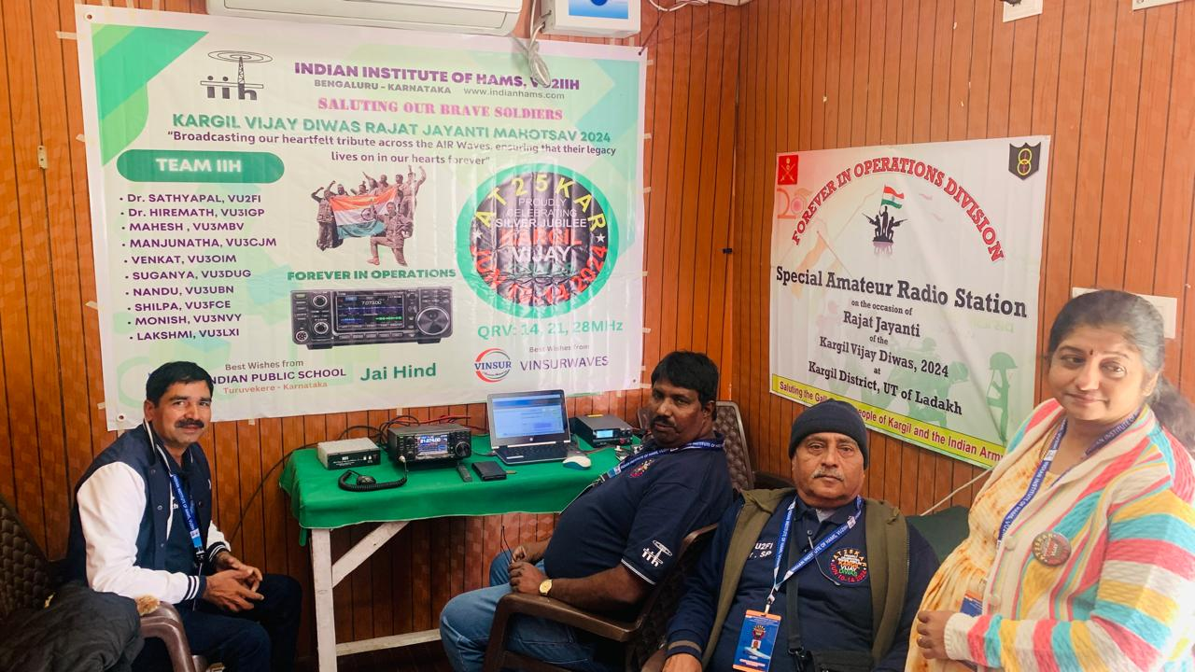
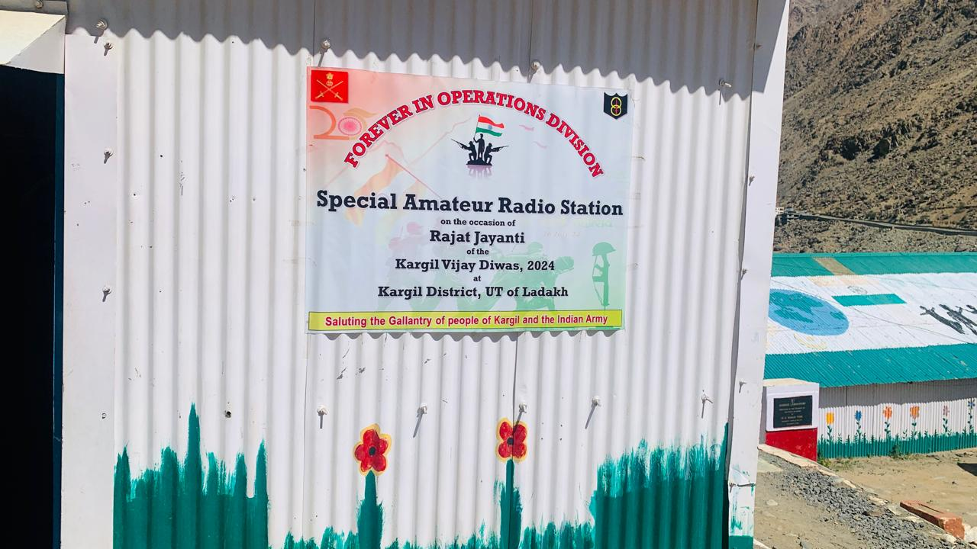
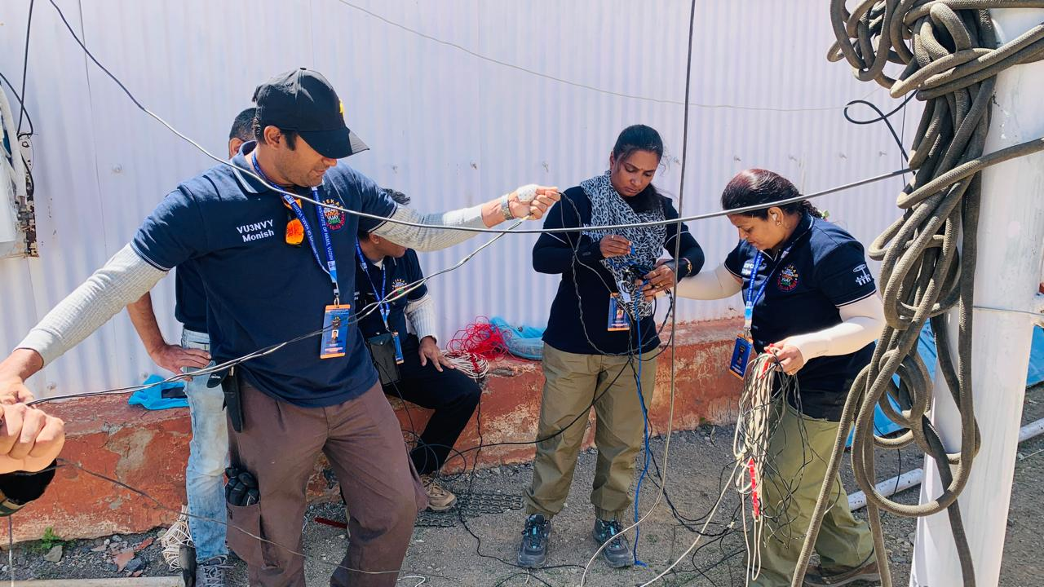
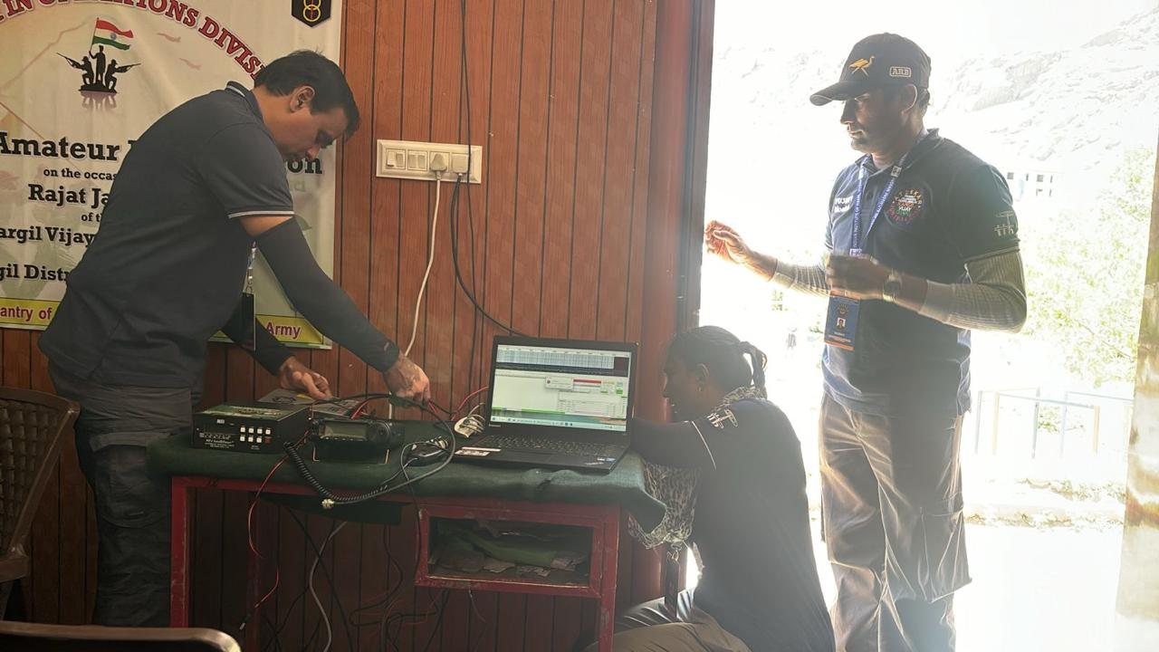
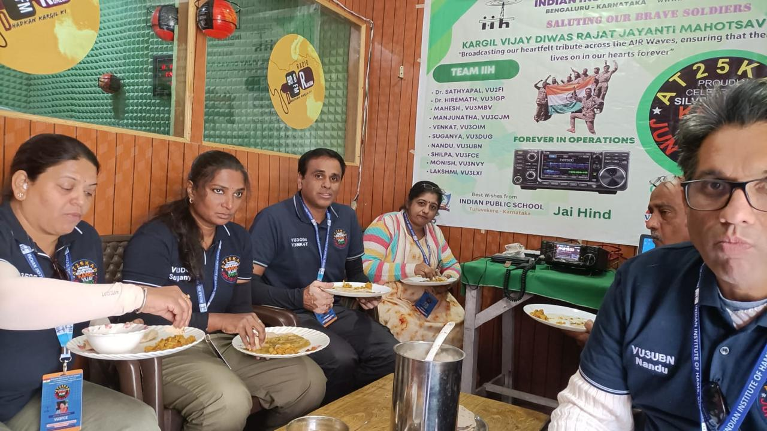
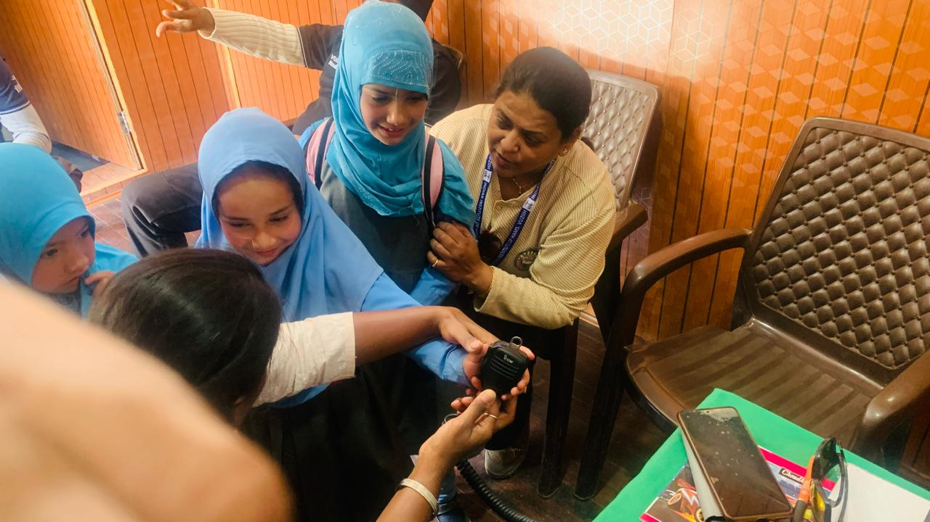
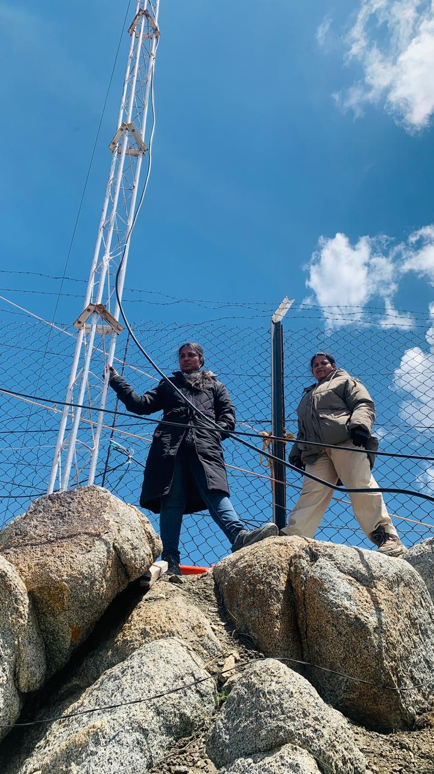
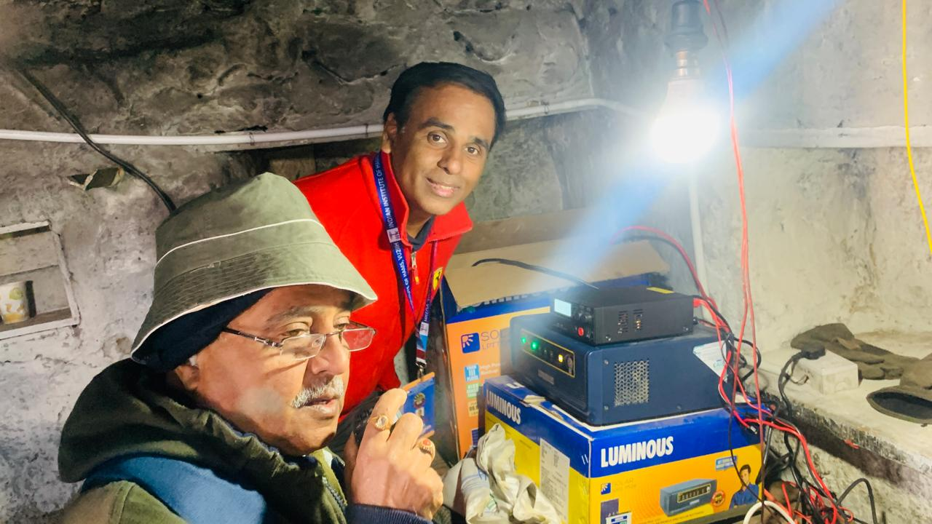
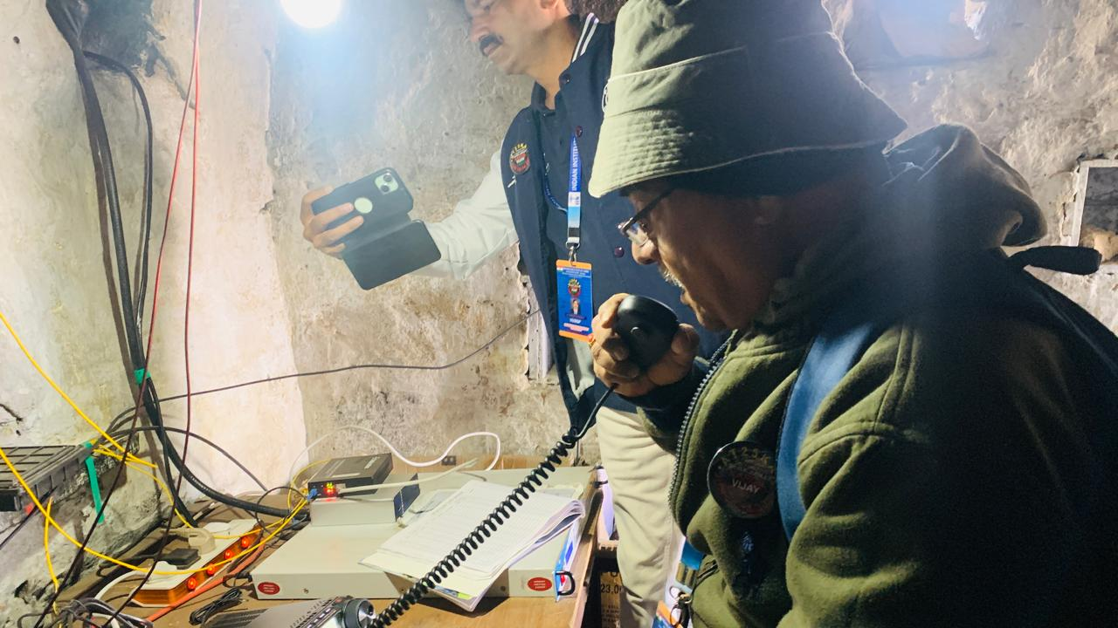

Slide 3
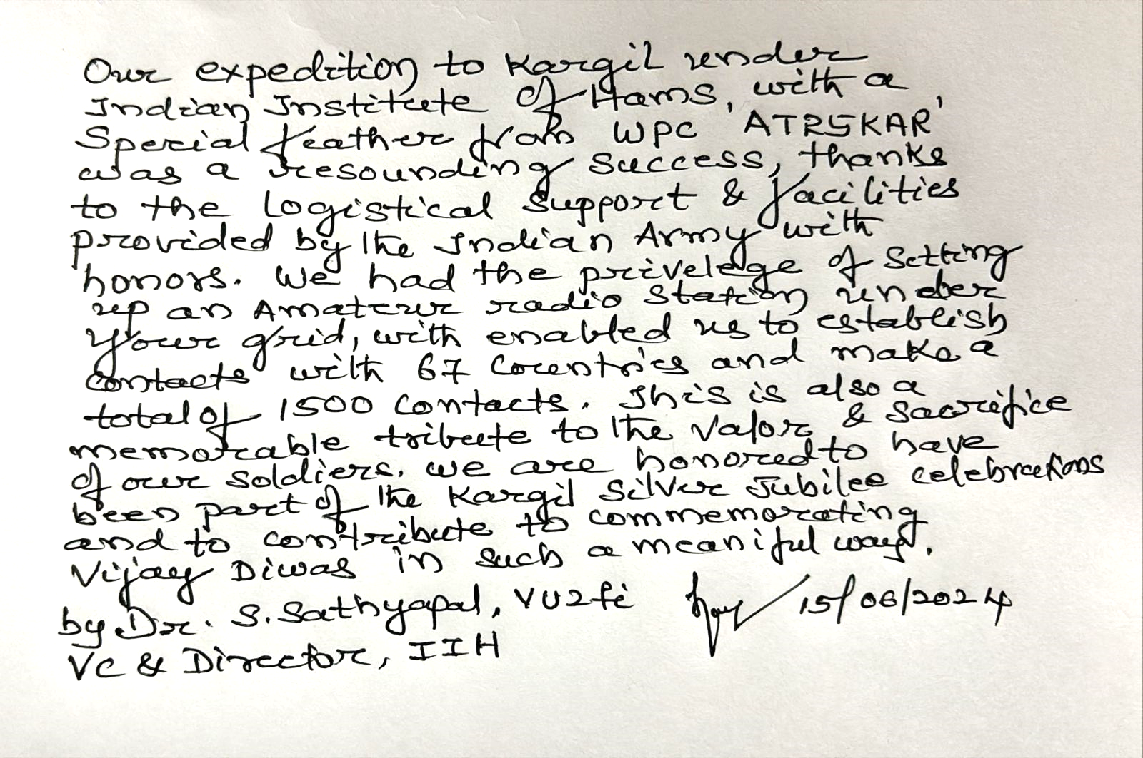
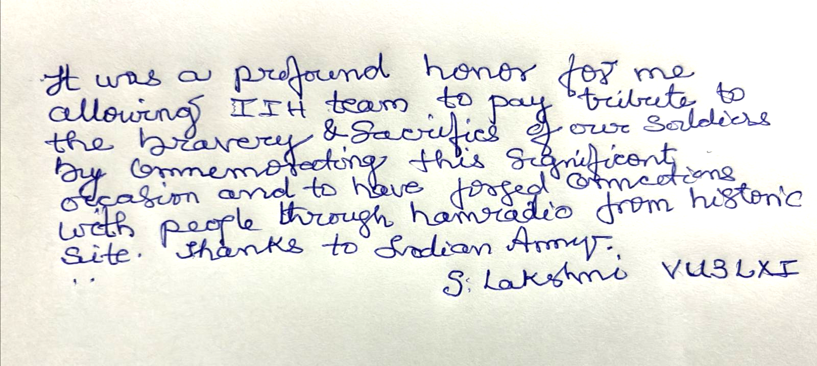
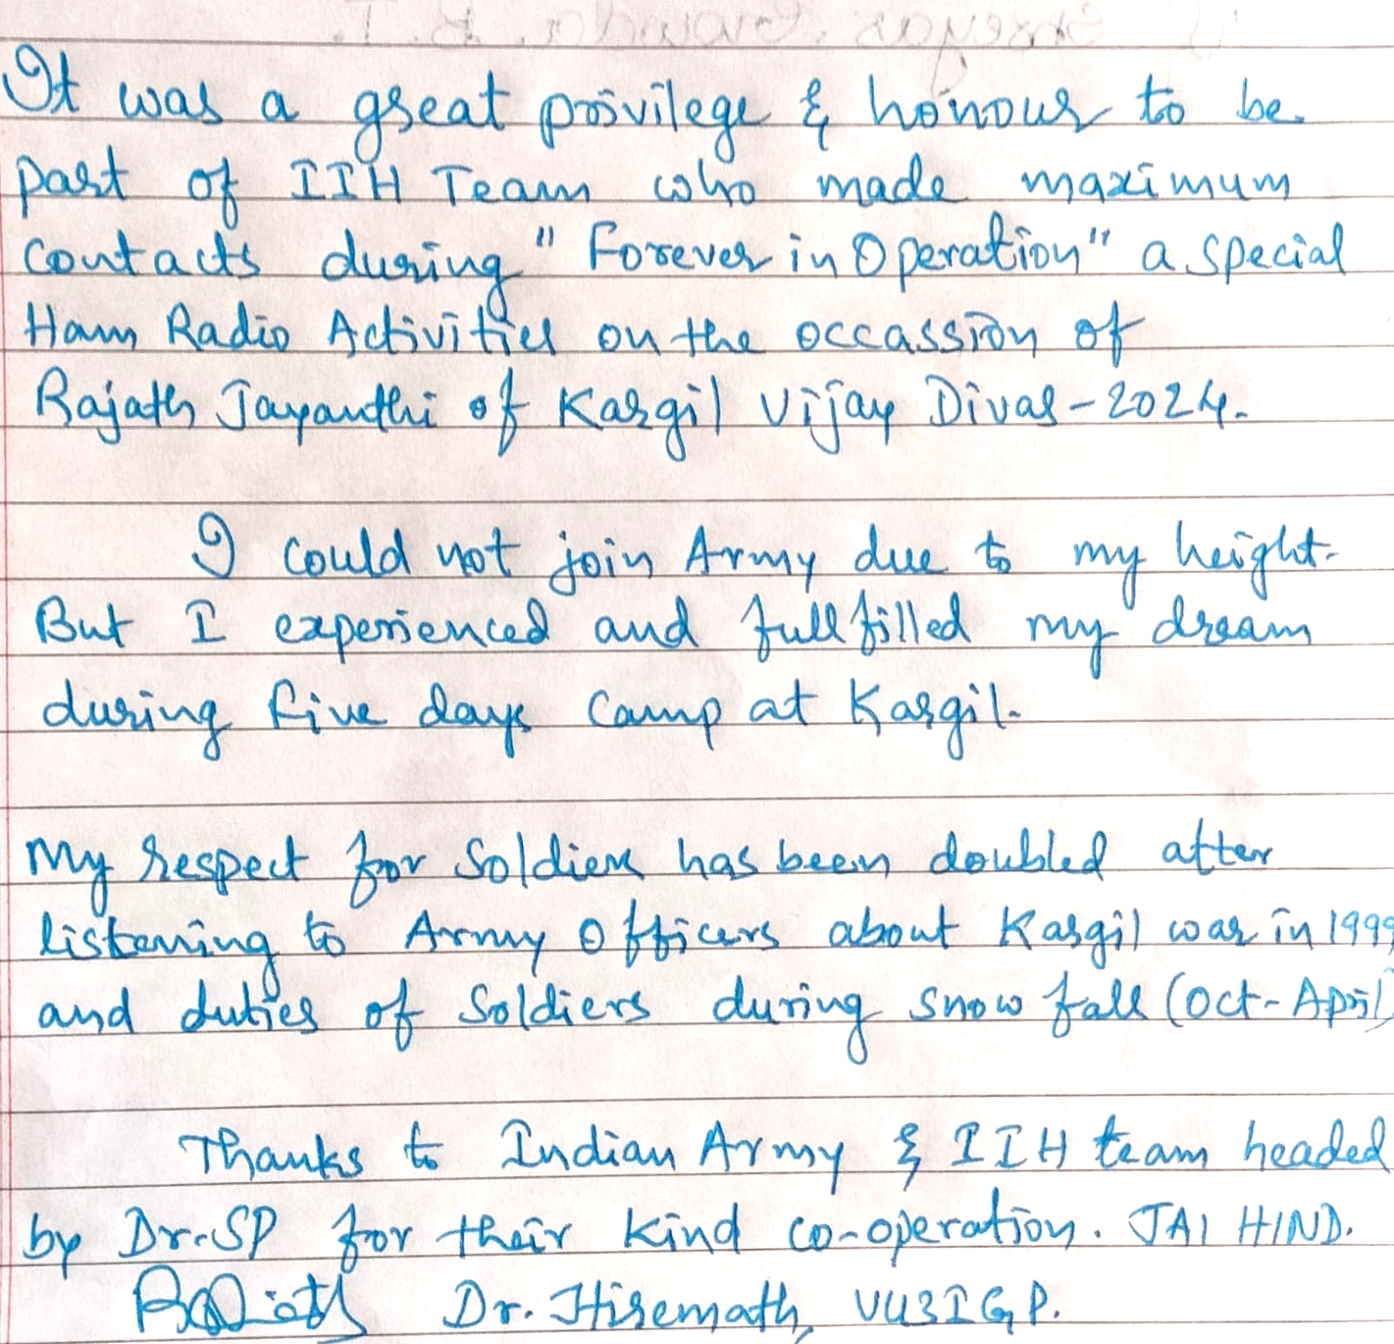
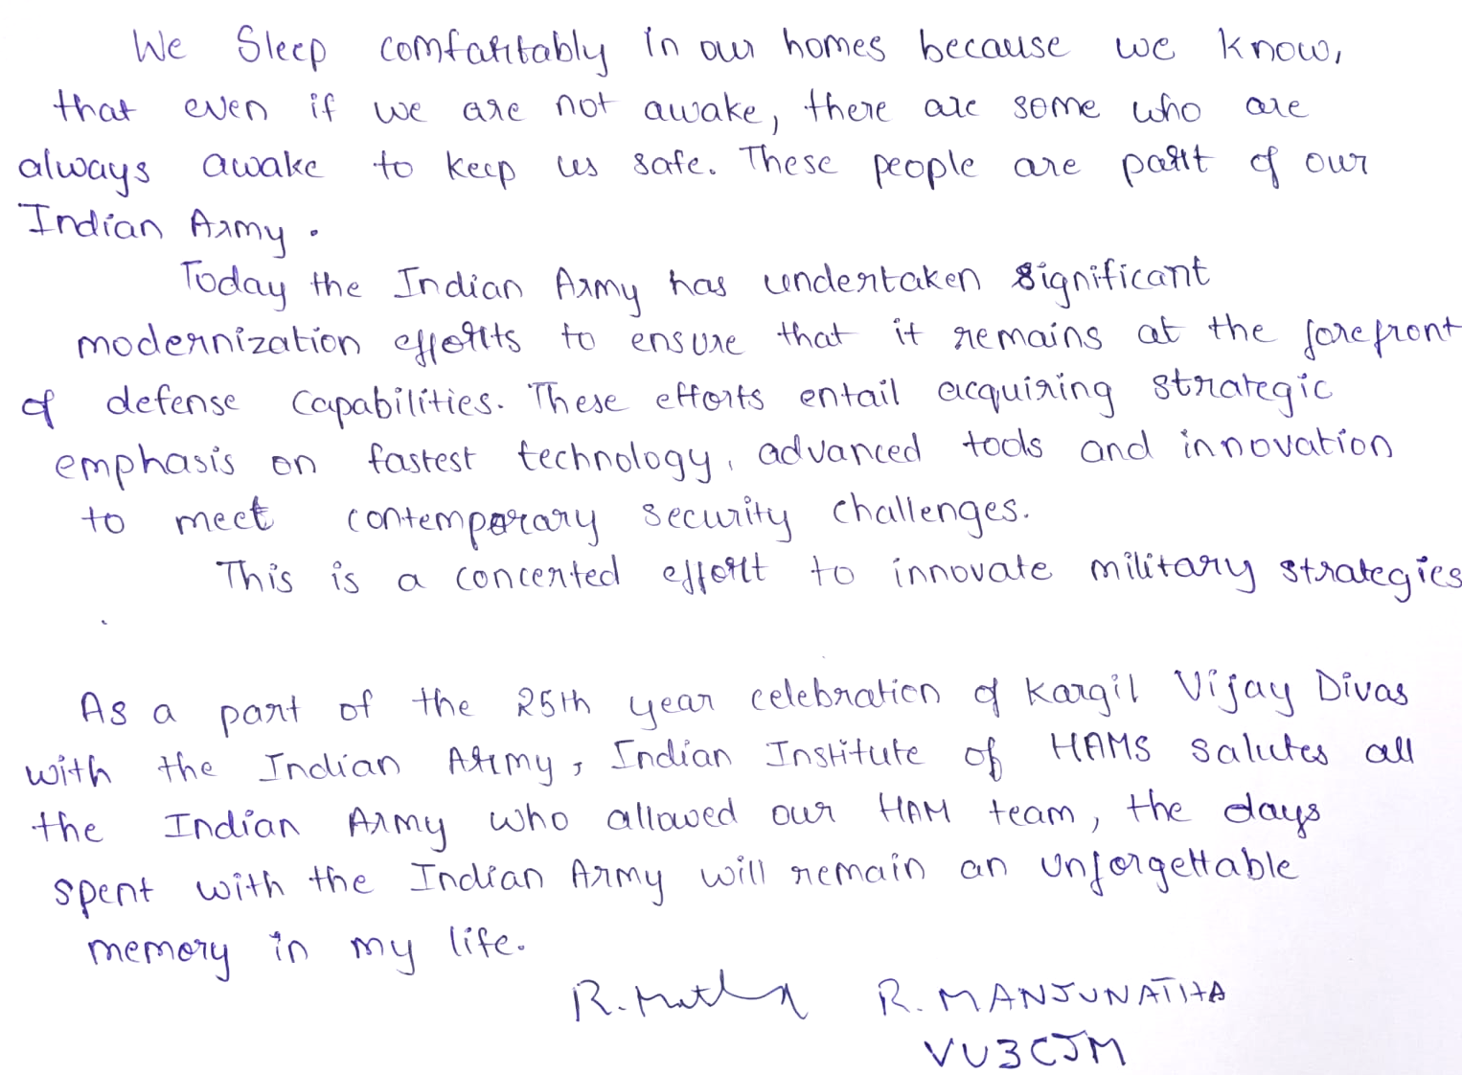
INDIAN INSTITUTE OF HAMS (VU2IIH) BENGALURU
Operated from 10/06/2024 – 14/06/2024

Slide 4
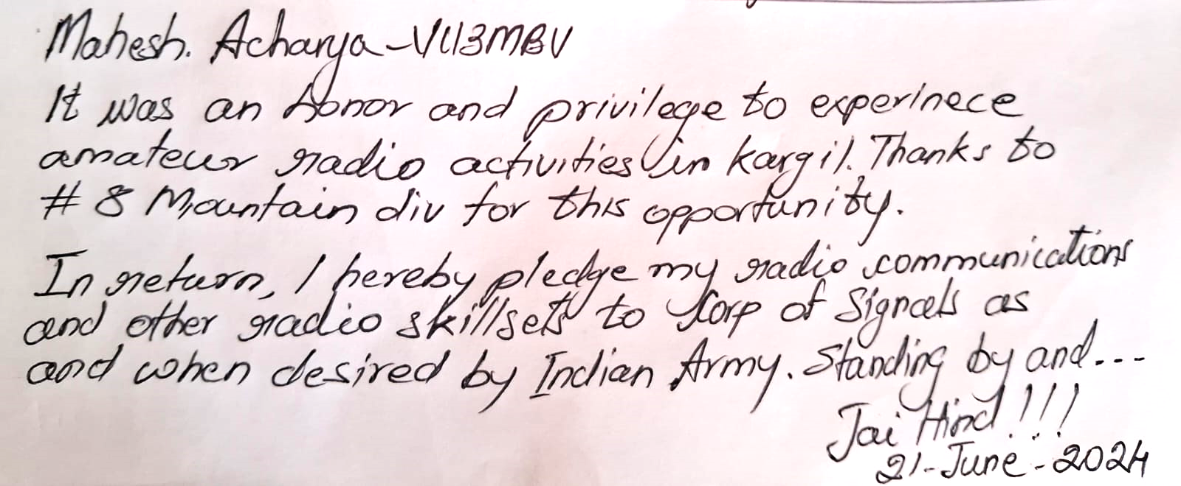
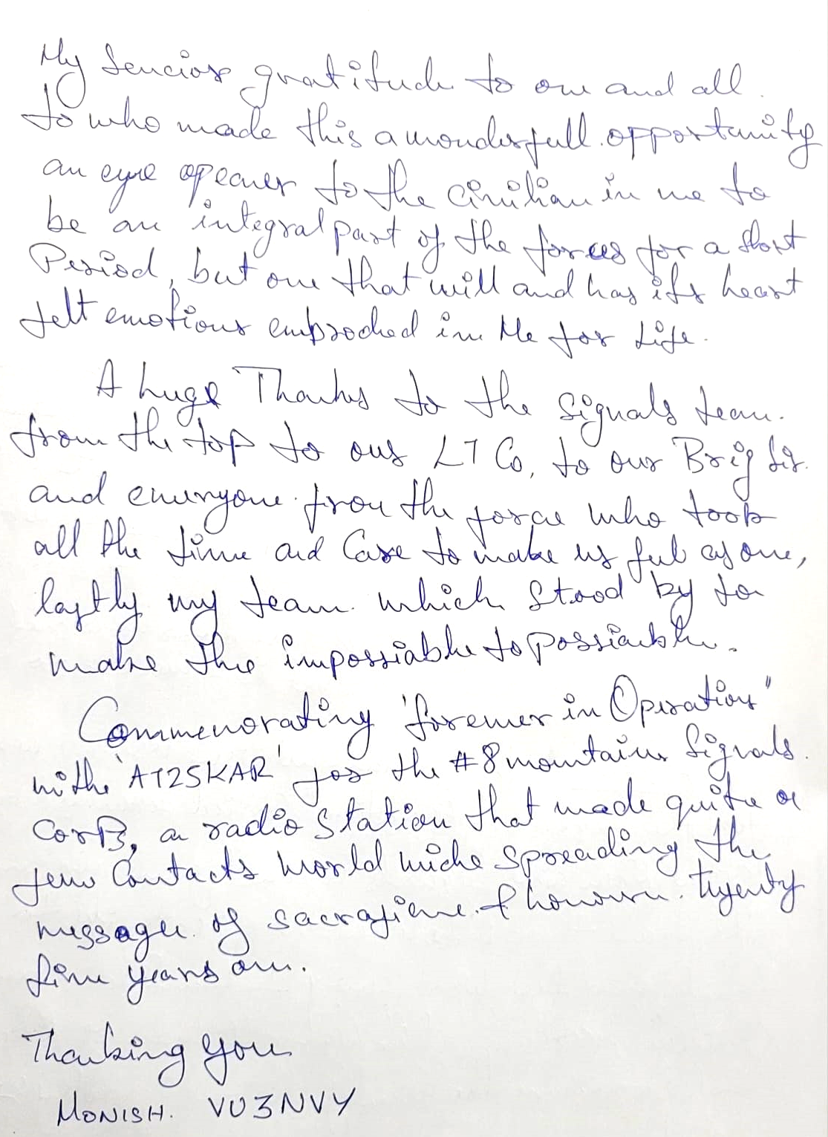
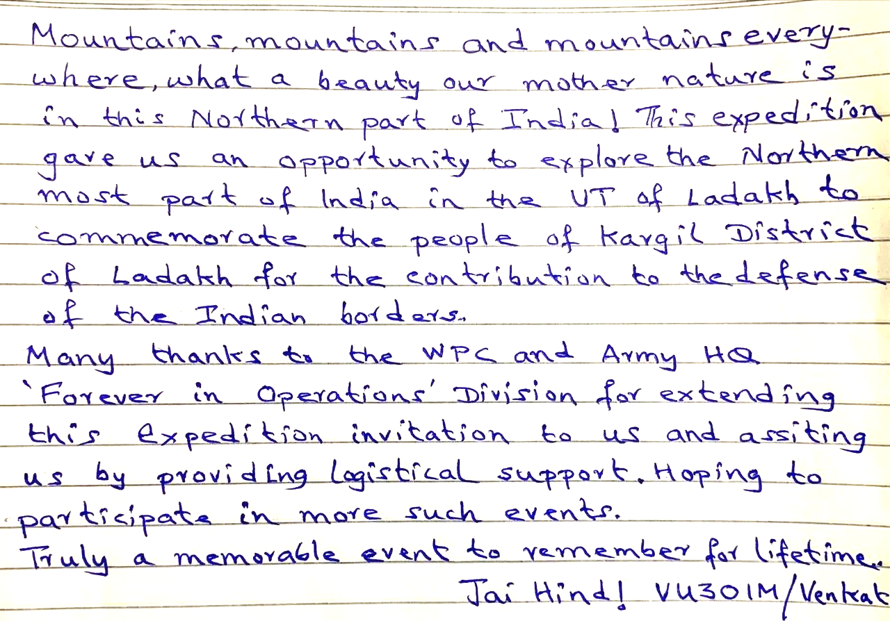
INDIAN INSTITUTE OF HAMS (VU2IIH) BENGALURU
Operated from 10/06/2024 – 14/06/2024

Slide 5
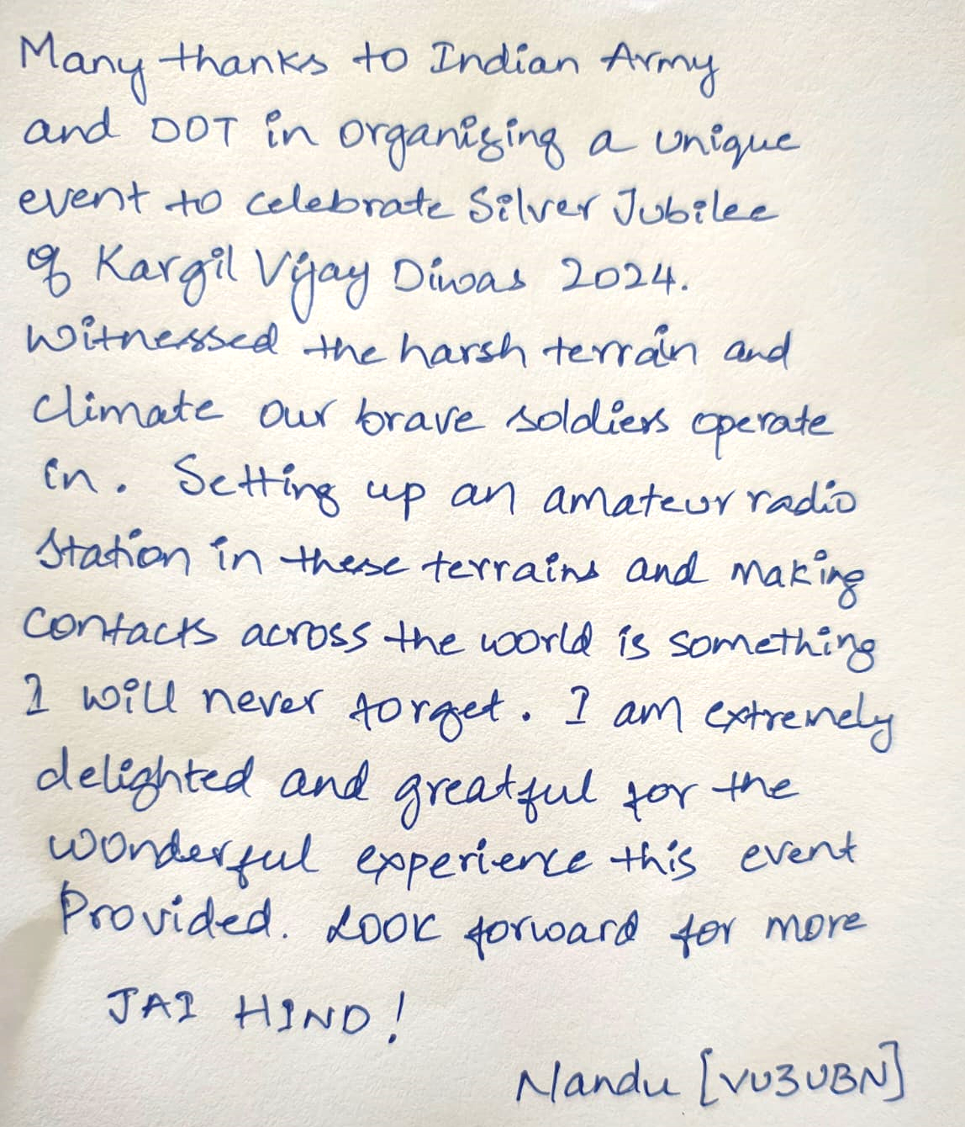
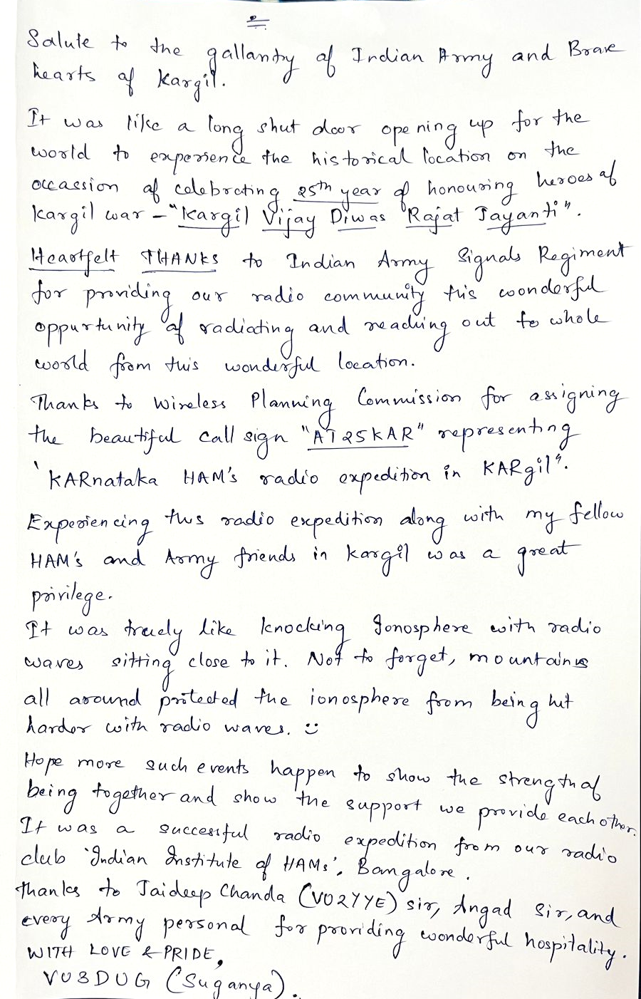
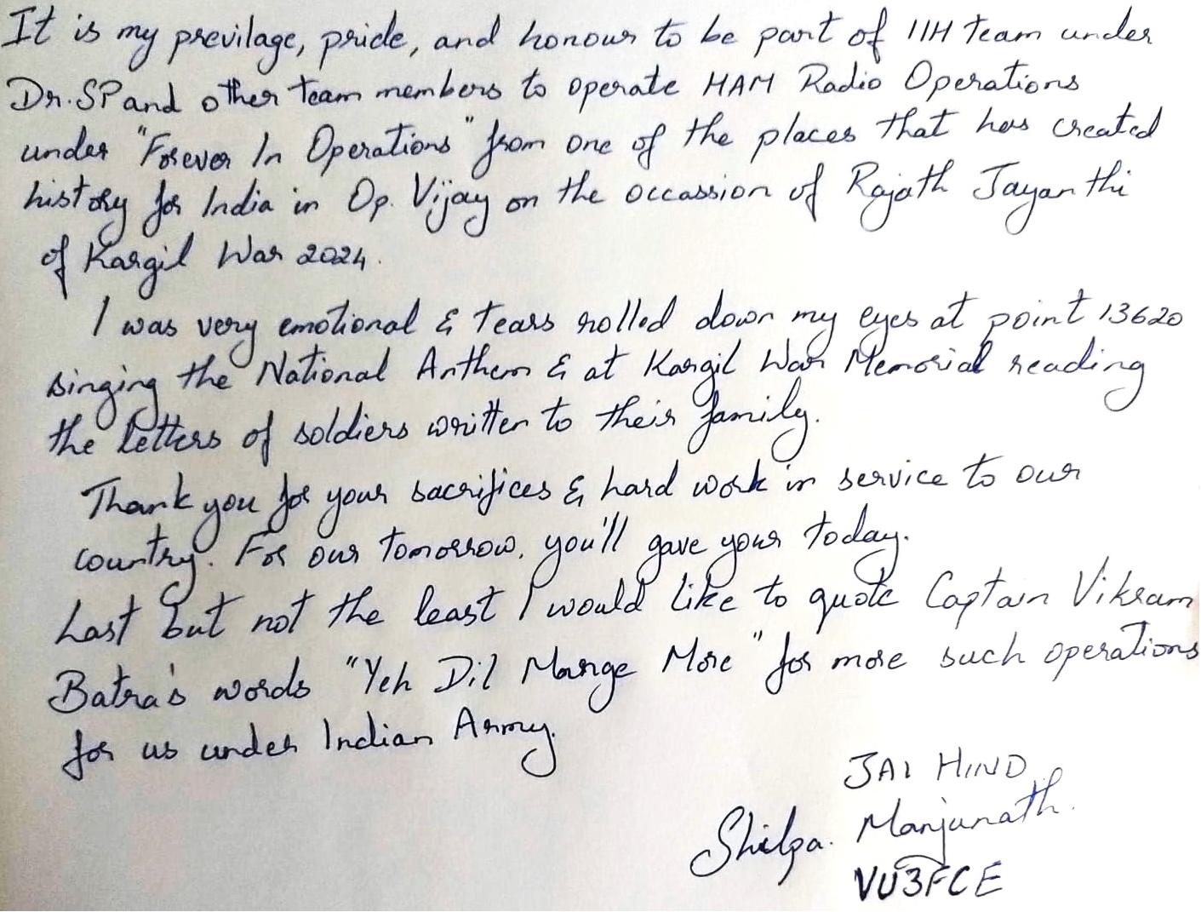
INDIAN INSTITUTE OF HAMS (VU2IIH) BENGALURU
Operated from 10/06/2024 – 14/06/2024

Slide 6
JAI HIND

